Slide 1

Back to Basics - Windows 10 and Windows 11 Setup Internals
Johan Arwidmark (@jarwidmark)

Slide 2
Windows ADK for Windows 11
Windows Preinstallation Environment (WinPE)
User State Migration Tools (USMT)
Windows System Image Manager (WSIM)
Windows Configuration Designer (WCD)
Command Line Tools (dism, oscdimg, wdsmcast etc.)
And more…

Slide 3
Windows ADK

Slide 4
Windows 10 and Windows 11 deployment scenarios
New Computer
Refresh Computer
Replace Computer
Inplace Upgrade
Use a tool that applies a WIM directly, don't use SETUP
You have to use SETUP whether you like it or not

Slide 5
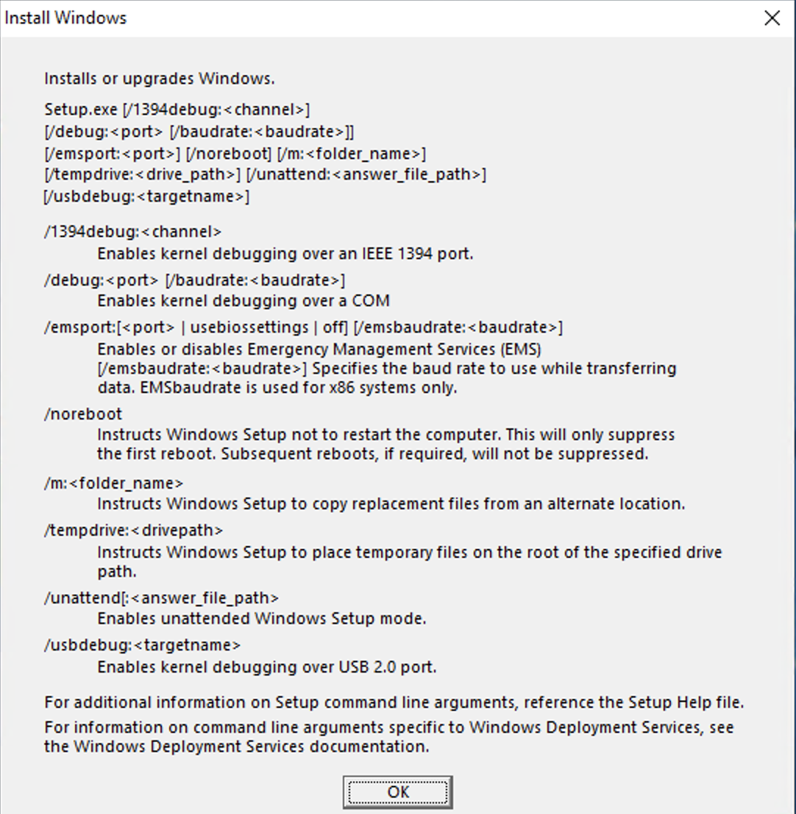
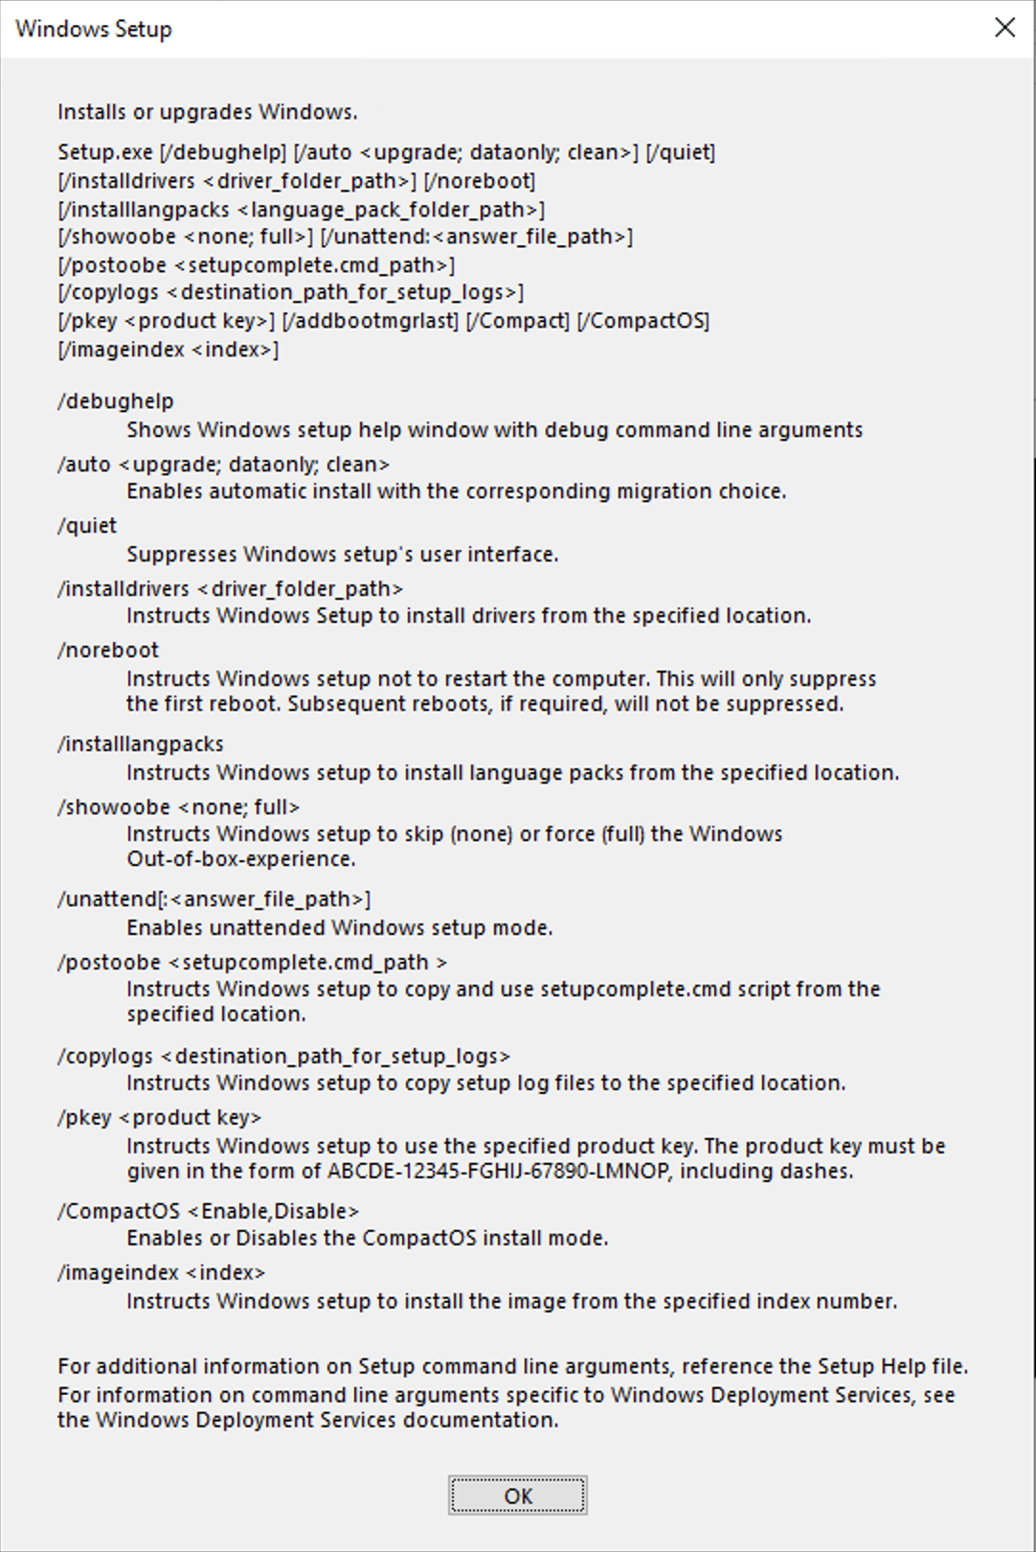
Command line switches
Windows Vista:
Windows 11:
"Relatively" new stuff:
/BitLocker {AlwaysSuspend | TryKeepActive | ForceKeepActive } 1803
/DiagnosticPrompt {Enable | Disable } 1703 (replaces https://oofhours.com/2020/08/04/disable-shift-f10-in-oobe/ )
/DynamicUpdate { Enable | Disable | NoDrivers | NoDriversNoLCU | NoLCU } 2004
/EULA accept 11
/SkipFinalize and /Finalize 2004
All command line options can also be put into SetupConfig.ini, see: https://www.asquaredozen.com/2019/08/25/windows-10-feature-updates-using-setupconfig-ini-to-manage-feature-updates-in-the-enterprise/
Notes:
The basic process hasn't changed since Windows Vista was released, but continues to be extended and optimized.
Notice that the help page doesn't list all of the available command line options.
The biggest change through the Windows 10 releases: fewer reboots and more work done in the background of the old OS during an upgrade; options to keep the device secure; options to control dynamic updating

Slide 6
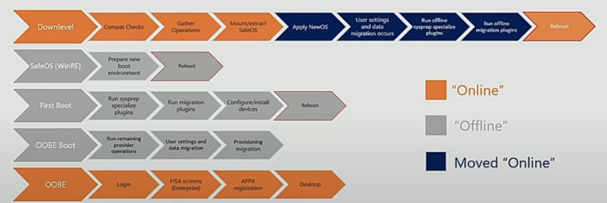
Inplace upgrades / Servicing
Solid, and well tested process
Four phases
Limitations
Reference Images
Architecture
SKUs:
Can't change from N/K to non-N/K
Can't change from SAC to LTSC, but you can go from LTSC to a later SAC
Can't change from BIOS to UEFI (but you can do that after the upgrade, as long as you don't want to roll back)

Slide 7
The Inplace-upgrade process

Slide 8
Integration with Deployments Solutions
MDT Lite Touch
ConfigMgr

Slide 9
Integration with Deployment Solutions

Slide 10
Splitting up the Upgrade process
SETUP.EXE /Compat ScanOnly
Check for compatibility (most useful with updated media or dynamic update so that you have the latest compatibility details)
https://techcommunity.microsoft.com/t5/windows-blog-archive/windows-10-pre-upgrade-validation-using-setup-exe/ba-p/706593
SETUP.EXE /SkipFinalize
Do the in-place upgrade up to the point where you reboot from the old OS into the recovery environment
SETUP.EXE /Finalize
Finish up the in-place upgrade, initiating the reboot into the recovery environment
WindowsUpdateBox.exe
Similar to SETUP.EXE /SkipFinalize and /Finalize, with one additional phase split out
https://smsagent.blog/tag/feature-updates-custom-process/
https://social.technet.microsoft.com/wiki/contents/articles/53479.sccmmemcm-windows-10-feature-update-rollouts-via-application-deployment.aspx
Used behind the scenes by Windows Update (where WindowsUpdateBox.exe is an equivalent front end to SETUPHOST), not supported for other uses

Slide 11
Working with drivers
Finding drivers
WinPE phase
Setup phase
Post-OS installation drivers
Drivers when Servicing

Slide 12
Working with Drivers

Slide 13
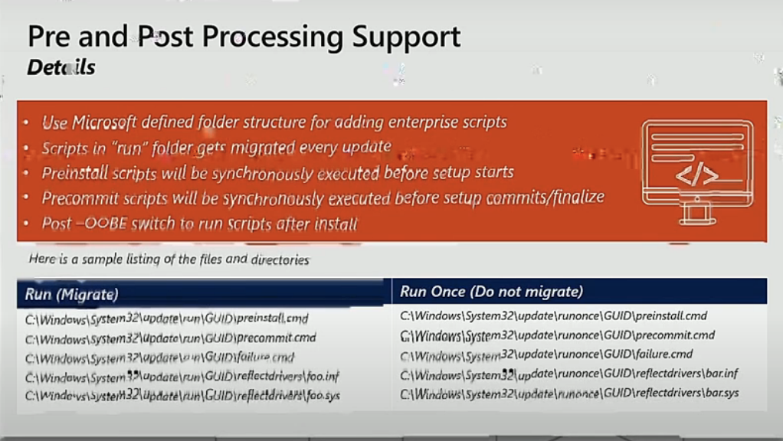
Pre- and Post-Processing support
If you are using a task sequence of some sort, you may not need this
Otherwise, you can place batch files in place for SETUP to run automatically during the in-place upgrade process
See https://docs.microsoft.com/en-us/windows-hardware/manufacture/desktop/windows-setup-enable-custom-actions

Slide 14
Reading logs
Find the logs
C:\$Windows.~bt\Sources\Panther
Use SetupDiag to try to get a quick result
Initially a separate download, included with SETUP.EXE as of Windows 10 2004
Point to a set of logs to have it try to find the errors
It might not be able to find a cause, so you may still need to dig deeper
https://docs.microsoft.com/en-us/windows/deployment/upgrade/setupdiag

Slide 15
Using SetupDiag

Slide 16
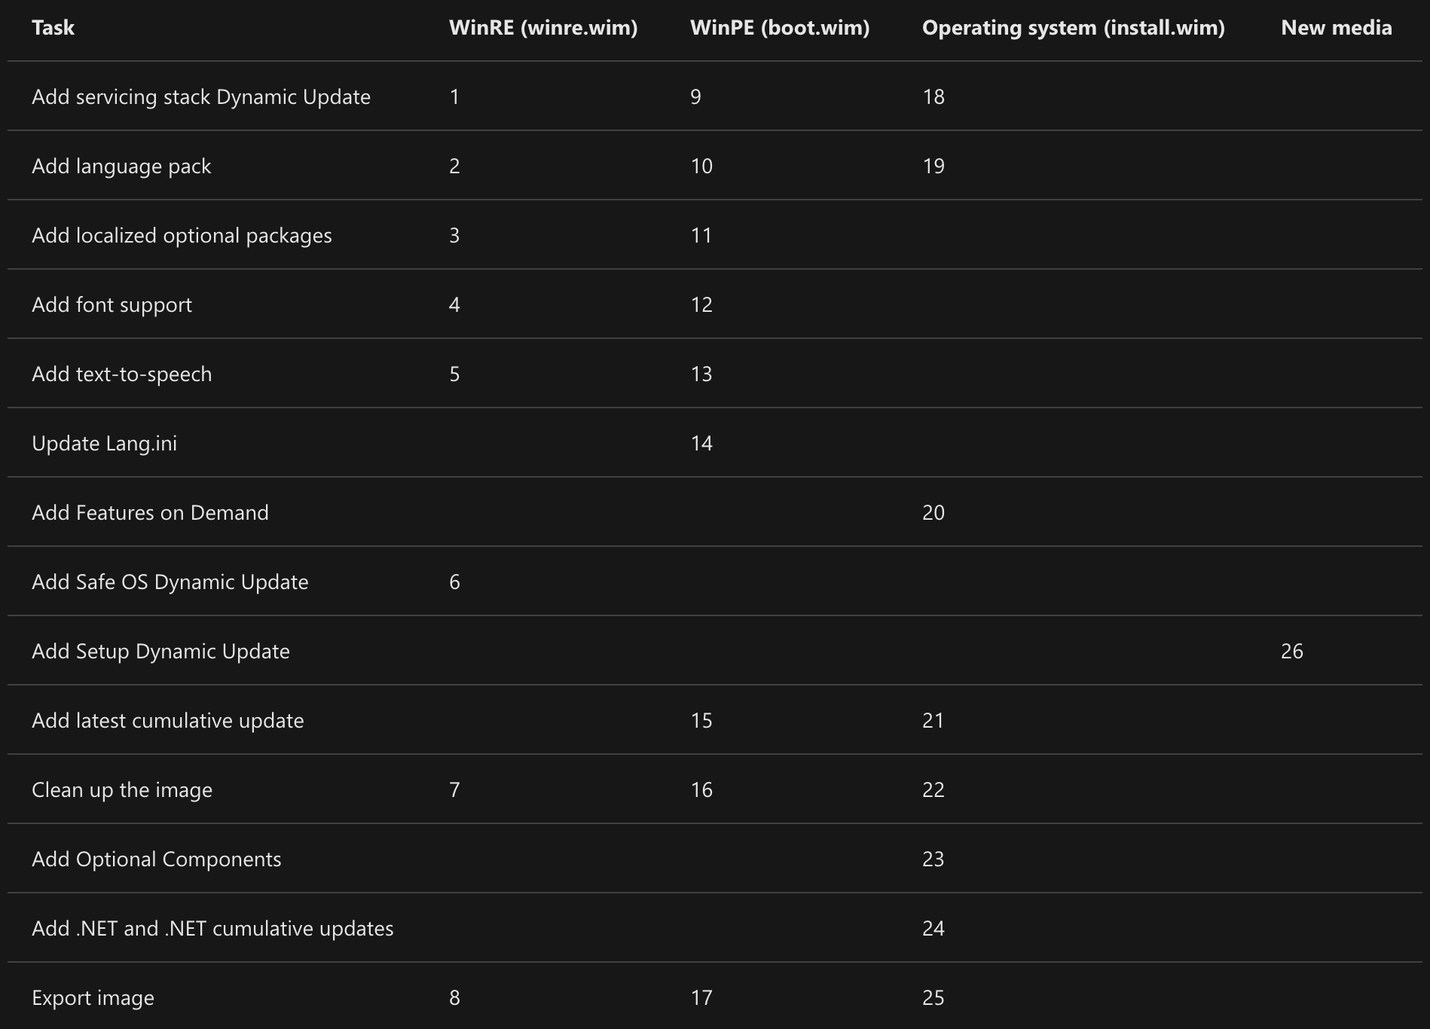
Updating Media
Ideally, you would always use the latest media when performing an in-place upgrade. The hard way of doing this is updating the media yourself each month.
See https://docs.microsoft.com/en-us/windows/deployment/update/media-dynamic-update for the "simple 26 step process"

Slide 17
Dynamic Update
Windows Setup uses dynamic update to grab all the latest pieces during the upgrade process
This can download many hundreds of gigabytes worth of stuff
This content is not available on WSUS, and (mostly) doesn't use Delivery Optimization
SCCM provided an option to make it work anyway by temporarily pointing the machine at Windows Update
Windows 10 1809 and later will bypass WSUS automatically and talk to WU
You can control some of what is downloaded (I.e. if you only want the latest compatibility databases):
/DynamicUpdate { Enable | Disable | NoDrivers | NoDriversNoLCU | NoLCU } 2004
See:
https://oofhours.com/2019/08/06/uup-is-still-coming-soon-and-dynamic-update-is-still-important/

Slide 18
Downloading updated media
The latest feature update releases are updated monthly on https://my.visualstudio.com and http://www.microsoft.com/vlsc
Download the new ISO each month and update your deployment tool
Injecting a single cumulative update can take as long as applying the image – it's a significant performance hit

Slide 19
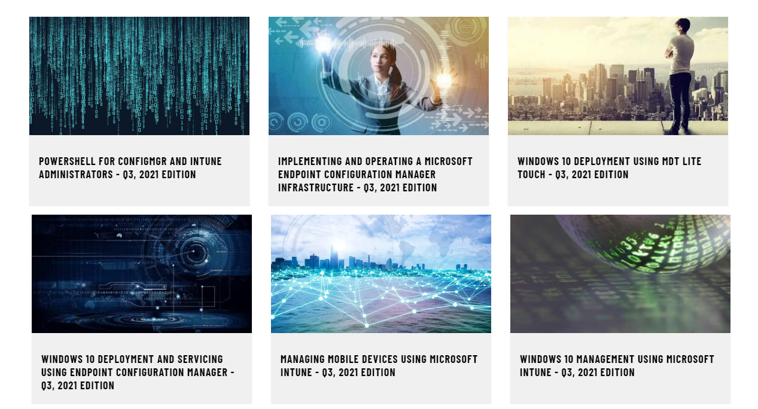
Resources – Trainings
https://academy.viamonstra.com

